Slide 1



Artificial Intelligence
Module Leader
Nipuna Senanayake
Lecture Time:
Friday – 10.30am – 12.30pm

Slide 2
About Me
Nipuna Senanayake
Email: nipuna.s@iit.ac.lk
Education:
Master of Science in Computer Science (Georgia State University, USA)
Bachelor of Science (Hons) (University of Kelaniya)
Work:
Informatics Institute of Technology (Senior Lecturer)
Georgia State University, USA (Graduate Research Assistant)
IgnitionOne, USA (Software Engineer)
Turner Broadcasting Corporation, USA (Software Developer)
hSenid Business Solution, SL (Software Engineer)
Virtusa, SL (Engineer)

Slide 3
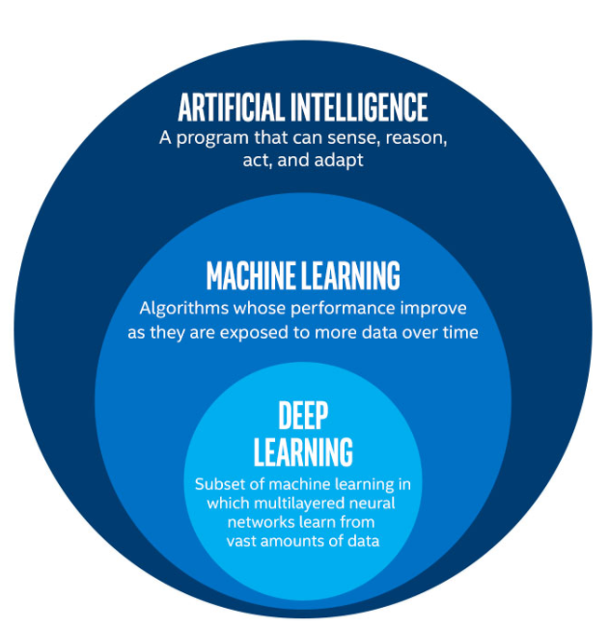
AI and ML
AI but Not ML:
Searching / Path finding Algorithms / Robotics
Ontology Engineering / Semantic Web
Prepositional / First order logic
ML but not Deep Learning
Regression
Decision Tree
SVM
K-means
KNN
Neural networks (Few layers)
Deep Learning
Deep NN
CNN
RNN
LSTM

